Slide 1
Software Engineering Concepts
Lecture 7
Requirements gathering
usman.anwar@cuiatk.edu.pk

Slide 2
What are requirements?
A requirement is ‘ something the product must do or a quality that the product must have’
Functional requirements
Non functional requirements
Problems (data gathering)

Slide 3
Needs Finding Techniques
Interviews
Direct Observation
Diary Studies

Slide 4
Interviews
One of the most effective ways of finding out what people want and what problems they have at the moment is to talk to them!
Interviews with all the various stakeholders in the domain is a vital way of gathering stories.
Designers employ a range of different styles of interview.

Slide 5
Interview types
Structured Interviews
Unstructured Interviews

Slide 6
Structured Interviews
Structured interviews use pre-set questions which are not varied by the interviewer
Public opinion polls, for example of the sort produced in great numbers before elections, are normally based on structured interviews.
Structured interviews are reasonably easy to carry out, simply because of the degree of pre-structuring.
However, people are limited to very restricted replies, and it is difficult for the interviewer to follow up the unexpected response.

Slide 7
Unstructured Interviews
Often, the interviewer simply prepares a checklist, sometimes with suitable prompts such as ‘Tell me about the first things you do when you get into the office in the morning ’.
Clearly, this free-form approach is more demanding for the interviewer, but the data obtained does generally repay the effort.
Completely unstructured interviews are sometimes used where it is particularly important to minimize designers’ preconceptions, or where very little background information is available beforehand.
As the term suggests, there are no preset questions or topics beyond the general subject of the project in question.

Slide 8
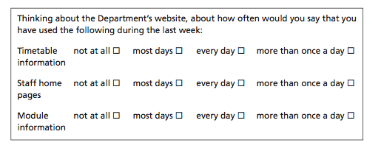
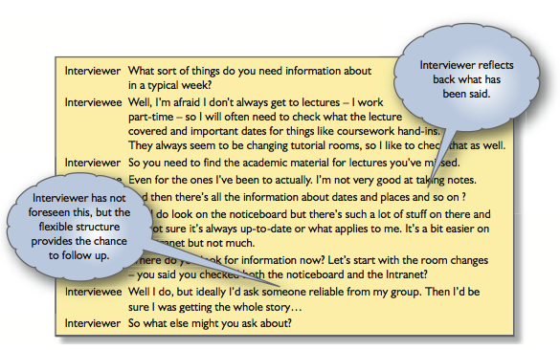
Example
Structured
interview
Unstructured interview

Slide 9
Practical considerations in interviewing: Preparation
Get to know the background.
‘Idiot questions’ can uncover unspoken assumptions, but use them deliberately, not by accident.
For work activities, background research might include studying company reports, brochures, websites and organization charts or scanning through software manuals and promotional materials.
For home and leisure activities, what is relevant depends very largely on the context.

Slide 10
Scenarios
Scenarios are real-life examples of how a system can be used.
They should include
  A description of the starting situation;
  A description of the normal flow of events;
  A description of what can go wrong;
  Information about other concurrent activities;
  A description of the state when the scenario finishes.

